Slide 1
Chapter 5 – Respiration

Slide 2
5.1 Respiration
You should be able to:
■ state that respiration takes place at the level of the cell;
■ describe the process of aerobic and anaerobic respiration;
■ distinguish between aerobic and anaerobic respiration;
■ demonstrate knowledge and understanding of the products of respiration; and
■ distinguish between breathing and respiration.

Slide 3
5.1 Respiration
Cellular Respiration
All living organisms require energy. The flow of energy
through the living systems occurs in three stages:
• The Sun’s light energy is used by plants during photosynthesis and converted into chemical energy in the form of organic molecules.
• Chemical energy is then stored into adenosine triphosphate (ATP) by cells in a process called respiration.
• ATP is used by cells as the energy source to carry out metabolic activities essential to life.

Slide 4
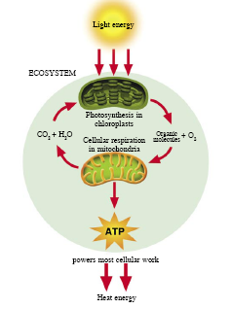
The flow of energy through the living systems

Slide 5
5.1 Respiration
Cellular Respiration
Many organic molecules are sources of chemical energy. Glucose is the nutrient most commonly used during respiration.
However, the chemical energy stored in glucose cannot be used directly by cells.
During cellular respiration, a series of reactions take place in cells to break down glucose, thus releasing the chemical energy from glucose and transferring it to ATP.

Slide 6
5.1 Respiration
Cellular Respiration
The process of energy transfer from glucose to ATP is not 100% efficient.
About 40% of the chemical energy is transferred to ATP and the remaining 60% is lost as heat energy.
Living cells thus emit heat – the internal source of heat required to maintain core body temperatures in mammals and birds.

Slide 7
5.1 Respiration
Cellular Respiration
Cellular respiration takes place all the time in the cells of living things. There are two types of respiration:
• Aerobic respiration
• Anaerobic respiration
Respiration may refer to either internal respiration (cellular) or external respiration (breathing).

Slide 8
5.1 Respiration
Cellular Respiration
Fats and proteins may also be oxidised to release energy when glucose stores run out during certain circumstances. E.g. a long distance race or periods of prolonged fasting and starvation.
Fats contain the most energy/gram compared to protein and carbohydrates. However, they are not preferred sources of energy as the energy cannot be delivered to muscles as fast as energy obtained from glucose.

Slide 9

5.1 Respiration
Aerobic Respiration
In the presence of oxygen, glucose is broken down to carbon dioxide and water, releasing a large amount of energy stored in ATP.
Respiration involving the use of oxygen is called aerobic respiration.
The overall equation is as follows:

Slide 10
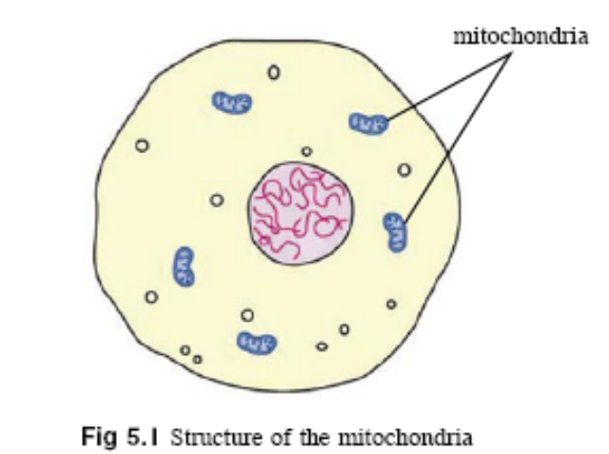
5.1 Respiration
Aerobic Respiration
The process of respiration is actually much more complicated than this. It involves a chain of reactions involving many enzymes and intermediate products.
Aerobic respiration takes place in the mitochondria of cells.

Slide 11
5.1 Respiration
Anaerobic Respiration
Respiration can also occur in the absence of oxygen – anaerobic respiration.
Anaerobic respiration produces less energy than aerobic respiration, but it is still a rapid and important source of ATP in conditions when oxygen is temporarily or permanently unavailable to an organism.
Anaerobic respiration takes place in the cytoplasm of cells.

Slide 12
5.1 Respiration
Anaerobic Respiration
Anaerobic respiration involves a process called
fermentation. There are two types of fermentation
that mainly occur:
• Alcoholic fermentation
• Lactate fermentation

Slide 13

5.1 Respiration
Anaerobic Respiration
Alcoholic fermentation occurs in organisms such as certain bacteria, fungi (e.g. yeast) and some plant cells (e.g. root cells). Carbon dioxide and alcohol (ethanol) are formed as waste products.
The overall equation is as follows:

Slide 14
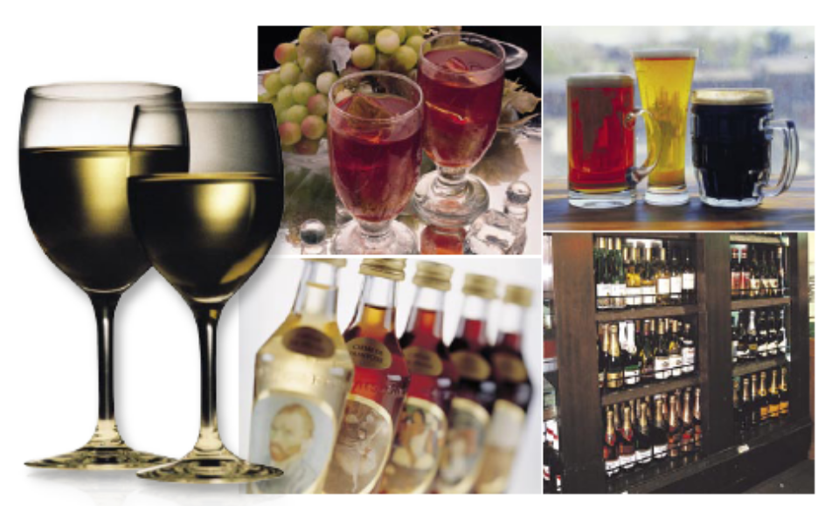
5.1 Respiration
Anaerobic Respiration
Alcoholic fermentation in bacteria and yeast has been exploited by humans for thousands of years to convert sugars to alcohol and other end products of value.

Slide 15
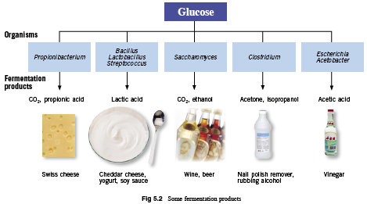
The diagram below shows some examples of fermentation products.

Slide 16

5.1 Respiration
Anaerobic Respiration
Lactate fermentation occurs in animals when there is temporary shortage of oxygen, such as animals living in water or deep underground. Lactic acid is formed as a waste product.
The overall equation is as follows:

Slide 17
5.1 Respiration
Anaerobic Respiration
Lactate fermentation occurs most commonly in the muscle cells during strenuous exercise, when oxygen is used up more rapidly than it can be supplied, thus incurring an oxygen debt.
To continue supplying sufficient energy to the muscles, the cells carry out anaerobic respiration which forms lactic acid as a waste product.
An oxygen debt is the volume of oxygen required to remove the lactic acid that has been built up.

Slide 18
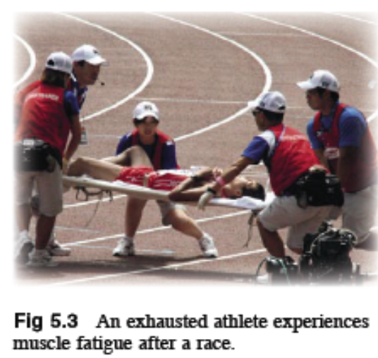
5.1 Respiration
Anaerobic Respiration
Lactic acid will cause cramps and muscle fatigue if it accumulates in the muscle tissue.
→ the muscles cannot contract and the body has to stop and recover.
Oxygen supply to the muscles becomes adequate again to repay the oxygen debt and anaerobic respiration stops.
Lactic acid is then sent to the liver to be either oxidised to release energy or converted to glucose.

Slide 19
5.2 Adenosine Triphosphate
You should be able to:
■ explain the role of ATP as a universal energy currency.

Slide 20
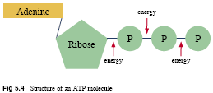
5.2 Adenosine Triphosphate
Adenosine Triphosphate (ATP)
ATP is the main energy currency used in all living cells.
The ATP molecule has three phosphate groups (P) linked together by unstable bonds. When these bonds break, a large amount of energy is released.

Slide 21

5.2 Adenosine Triphosphate
Adenosine Triphosphate
When energy is required by the living cell, the terminal phosphate group is removed and ATP is converted to adenosine diphosphate (ADP) in a reaction as follows:

Slide 22
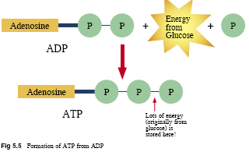
5.2 Adenosine Triphosphate
Adenosine Triphosphate
The conversion of ATP to ADP is a reversible reaction
→ energy can be used to add an inorganic phosphate to ADP and reform ATP.

Slide 23
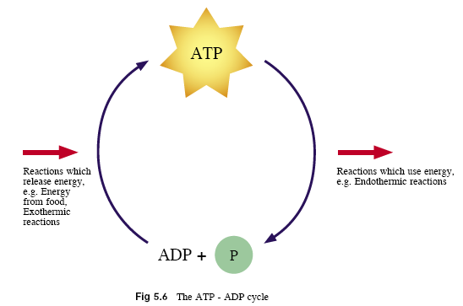
5.2 Adenosine Triphosphate
Role of ATP in Energy Transfer

Slide 24
5.2 Adenosine Triphosphate
ATP is the source of energy for:
• Anabolic processes – larger, complex molecules are built up from smaller, simpler molecules;
• Movement – during muscle contraction, beating of cilia and flagella;
• Active transport – molecules or ions are moved against a concentration gradient;
• Secretion – to form vesicles needed for the secretion of cell products.
• Generating nerve impulses – bioluminescence.

Slide 25
Key Concepts
The ultimate source of energy in most ecosystems is light energy from the sun. During photosynthesis, plants transform light energy into chemical energy.
In respiration, glucose is broken down in cells to convert chemical energy stored in glucose into the energy in Adenosine Triphosphate (ATP).
ATP is used by cells as the energy source to carry out metabolic activities essential to life.
During respiration some of the energy is lost as heat to the environment.

Slide 26
Key Concepts
In aerobic respiration, which takes place in the mitochondria of cells, glucose is oxidised in the presence of oxygen to release a large amount of ATP. Carbon dioxide and water are waste products.
Anaerobic respiration takes place in the cytoplasm of cells when oxygen is absent. Less energy is released. Anaerobic respiration involves fermentation reactions.
In microorganisms such as bacteria and yeast, alcoholic fermentation occurs and releases carbon dioxide and ethanol as waste products.

Slide 27
Key Concepts
Lactate fermentation occurs in muscle cells during strenuous exercise when an oxygen debt occurs. Lactic acid is produced and is toxic to cells if accumulated. It is oxidised in the liver to release energy or produce glucose.
The ATP molecule has unstable bonds between their phosphate groups. When these bonds break, a large amount of energy is released and ATP is converted to Adenosine Diohosphate (ADP) in a reversible reaction.

